Slide 1
ISM 6562
Big Data for Business
Dr. Tim Smith

Slide 2
Guiding Agenda
10:00-10:25 - Introductions
10:25-10:40 - Review syllabus
10:40-11:00 – Technical Foundations
Git/GitHub
Terminal
VMs and Docker
Break
11:00-12:00 - Introduction to Analytics, Data Mining, and Big Data
Rationality in decision-making
The rise of big data
Scaling for big data
12:00-12:10 - Introduce DataCamp, get everyone signed up
12:10-12:20 - Class recap, questions, deliverables this week, and preparing for next class

Slide 3

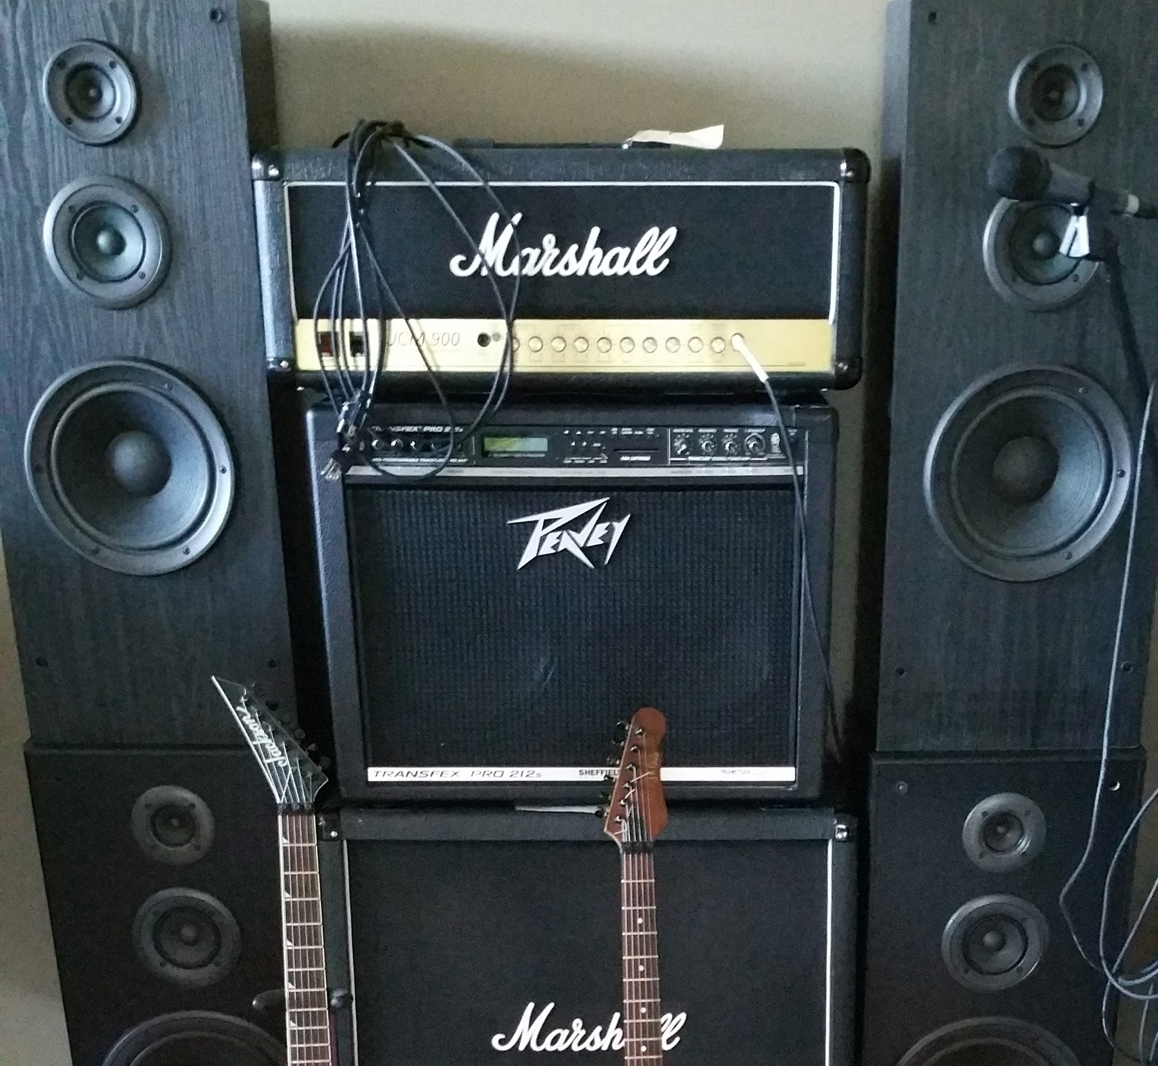
Meet your professor
Dr. Tim Smith
PhD in Business Information Systems
Research Interests include technology adoption , organizational routines, health information technology, and application to deep learning models to cryptocurrency and blockchain. Coauthoring a textbook on Business Analytics (Prospect Press).
20+ years of professional experience
Systems programmer
Founder, and president of a software development company
Systems Architect
Telecom Executive
In my spare time, I like to travel, hike, fly-fish, and play guitar.

Slide 4
Introduce Yourselves
Introduce yourself to the class
Use discussion forum
This is ‘marked’
Say hello and comment on other postings from fellow classmates.
Tell them your name, and one interesting thing about yourself:
i.e., mine was that I played lead guitar in a heavy metal band

Slide 5
Our Approach

Slide 6
What, Why and How
What
What are the technologies
Why
Why do we need them
When
Under what conditions will we choose ‘them’
How
How do we implement and use them?

Slide 7
Course Introduction

Slide 8
ISM6562 – Big Data for Business
Review Syllabus
Review Academic Integrity Policy (Cheating)
Review Canvas and how to navigate course content

Slide 9
Server/Dev Environment Introduction

Slide 10
Accessing our class VM
Let’s walk through connecting to class VM

Slide 11
Introduction to Analytics, Data Mining and Big Data

Slide 12
Learning objectives
Understand what Solow’s Paradox is/was, and how this is changing in today’s data driven world.
Understand big data, and the 6v’s
Situate Data Mining and Data Analytics within the large scope of data science.
Describe the four types of data analytics.
Describe some examples of the use of data analytics in business.

Slide 13
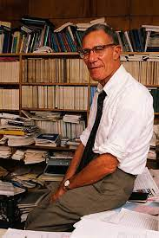
1987….
“You can see the computer age everywhere but in the productivity statistics“.
Robert Solow, 1987

Slide 14

Today…
Since 2002, the top 5% of companies have increased productivity by 40%, while the other 95% of companies have barely increased productivity at all.
Andy Haldane, Chief Economist for the Bank of England

Slide 15
What explains this?
Some companies have found a solution to Solow’s Paradox and are rapidly improving their productivity.
Economists continue to explore what’s behind this trend, but a few things are clear
The Internet is increasing the rate of consolidation in many industries.
Differentiation is even more important today!
Effective use of data analytics and machine learning are being leveraged to improve and automate business processes and decision making.
Clearly, some companies do a better job at this than others!
Data, and access to information from this data is driving tremendous competition advantage and growth.

Slide 16
Data is everywhere…
2.5 quintillion bytes of data generated each day
Over the last two years, we’ve generated 90% of all the data that has ever been generated!
We conduct more than half of our web searches from a mobile phone now.
More than 3.7 billion humans use the internet (that’s a growth rate of 7.5 percent over 2016).
On average, Google now processes more than 40,000 searches EVERY second (3.5 billion searches per day)!
See the infographic here (https://web-assets.domo.com/blog/wp-content/uploads/2017/07/17_domo_data-never-sleeps-5-01.png)

Slide 17
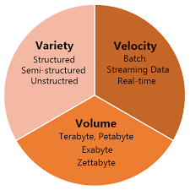
Big Data: The 3vs
Volume: This refers to the amount of data. With the advent of the internet and the rise of cell phone use and IoT, we are seeing exponential growth in data produced.
Variety: The variety of data is expanding – videos, audio, web interactions, geographic location, images, emails, etc.
Velocity: The speed of data production is increasing.
In 2022, 333.2 billion emails are sent every day.
In 2021, people created 2.5 quintillion bytes of data every day.
In 2022, users sent around 650 million Tweets per day.
In 2021, people created 2.5 quintillion bytes of data every day.

Slide 18
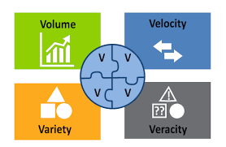
Other Systems: Big Data – 3Vs and 4Vs
Veracity: Refers to the quality of the data; where the data has been collected from, how it was collected, and how it will be analyzed.
The veracity of a users data, dictates how reliable and significant the data really is.

Slide 19
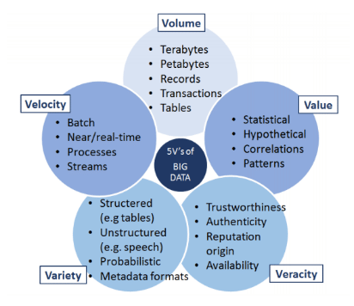
Other Systems: Big Data – 5 Vs

Slide 20
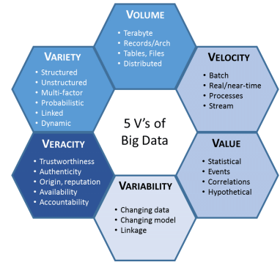
Other Systems: Big Data – 6 Vs
6 V’s of Big Data
Note: Some experts have kept adding new V’s (i.e., 17!) – but beyond 6 is probably not necessary or valuable.

Slide 21
History of Big Data
The term was coined in the 90s
typically credited to John Mashey from Silicon Graphics
But, we have been dealing with ‘big data’ challenges since ancient times:
300 BC: Attempt to capture all existing ‘data’ in the Alexandria library
Roman Empire analyzed data to determine optimal distribution of their armies

Slide 22
Big Data Phase 1 | Big Data Phase 2 | Big Data Phase 3
Period: 1970-2000 | Period: 2000-2010 | Period: 2010-present
RDBMS Based structured content: RDBMS and Data Warehousing | Web-based Unstructured content: Information retrieval and extraction | Mobile and Sensor Based Content Entity-centered analysis (i.e., person)

Slide 23
From a business perspective
How do you store and process the data in a specific use-case scenario?
Will a single computer suffice?
Can we utilize a single system, or ‘scale up’ the capacity of a single system to handle the job?

Slide 24
Vertical vs Horizontal Scaling
Big Data systems make distributing storage and processing across multiple nodes easier to accomplish
What was extremely technically challenging and costly to do has become much easier and less costly.

Slide 25
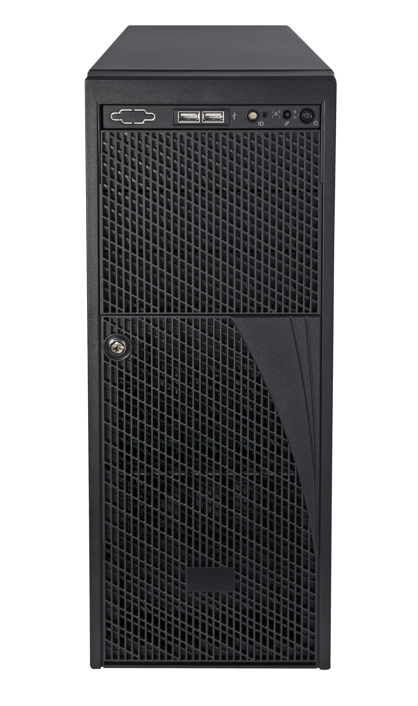
Vertical Scaling
Increase the number of CPU cores
Increase the amount of RAM
Increase the storage disk space

Slide 26
Horizontal Scaling
Increase the number of systems
Utilize systems/software technologies that distribute storage and processing across multiple computers

Slide 27

How much performance does the use case require?
Multi-Node
Performance
Single Node
Cost

Slide 28
Discussion
What’s an RDBMS?
What are they good for? What contexts are they possibly not the best solution?

Slide 29
Scaling – Incorporating Big Data Systems
Horizontal Scaling
Performance
With big data tools
Horizontal Scaling
With RDBMs
Vertical Scaling
Modern RDBMs can scale horizontally, but efficiently as big data systems.
Cost

Slide 30
Data Lake and Data Warehouse

Slide 31
See Notes:
You should receive an invitation to join or GitHub organization
If you don’t already have one, create a github account
Use your USF email
Accept the invitation to the class organization on GitHub
ISM6562-GBAIS/ClassMaterial (github.com)

Slide 32
DataCamp

Slide 33
Data Camp
I’ve arranged for each one of you to have access to DataCamp for five months.
These courses are part of the supplemental material - I will not assign you any courses.
Accept the invitation and create an account using you USF email

Slide 34
Summary

Slide 35
Summary
We have reviewed the syllabus, canvas, and datacamp.
You are now subscribed to datacamp
You can connect to the Cyberhub VM Server
You understand some of the challenges of big data analytics
You know the 3+ V’s of big data
You understand the benefits and costs of vertical versus horizontal scaling.

Slide 36
Next Class
Be sure that you have created a GitHub account.
Accept the invitation to our Class Organization on GitHub
We will cover the Technology Foundations of this Course:
Introduction to Shell
Introduction to Git/GitHub
Introduction to VMs and Containers

Slide 37
Happy Learning!

